Slide 1
Program
Load models
Detect faces
Detect masks
Draw boxes around faces
Take a frame from the video stream

Slide 2
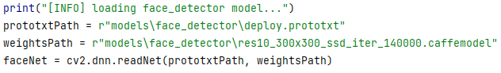
Program
Load models
Load models
1. Load the face_detector:
Detect faces
Detect masks
Draw boxes around faces
Take a frame from the video stream
We used pretrained opencv_3rdparty DNN, by opencv team: link:res10_300x300_ssd_iter_140000.caffemodel
2. Load the mask_detector:

Slide 3
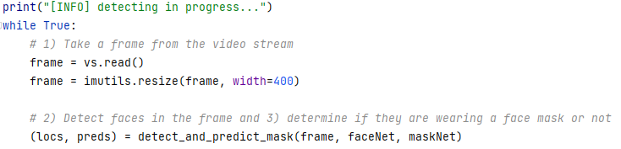
Program
1) Take a frame from the video stream
Load models
2) Detect faces
4) Draw boxes around faces
1) Take a frame from the video stream
3) Detect masks

Slide 4
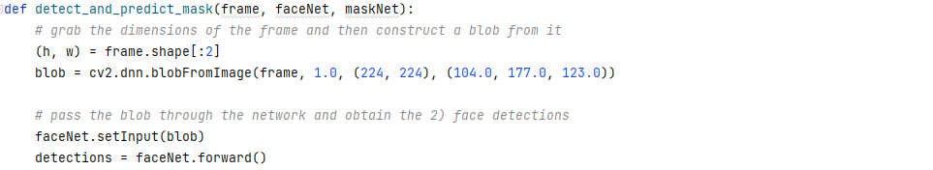
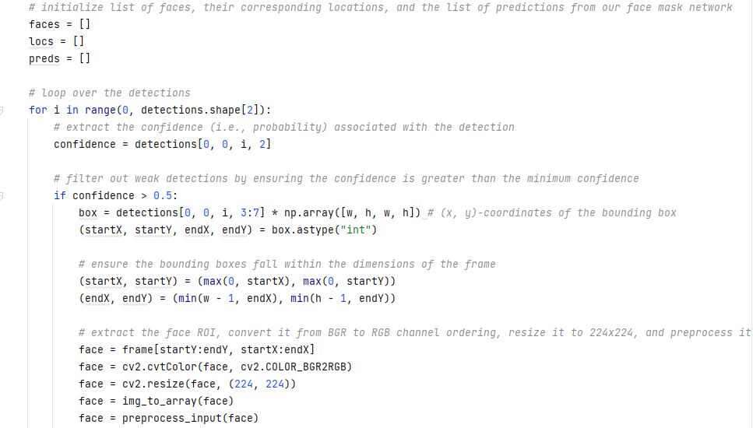
Program
2) Detect faces
Load models
2) Detect faces
4) Draw boxes around faces
1) Take a frame from the video stream
3) Detect masks

Slide 5
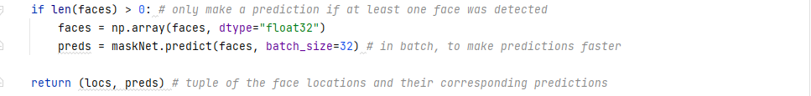
Program
3) Detect masks
Load models
2) Detect faces
4) Draw boxes around faces
1) Take a frame from the video stream
3) Detect masks

Slide 6
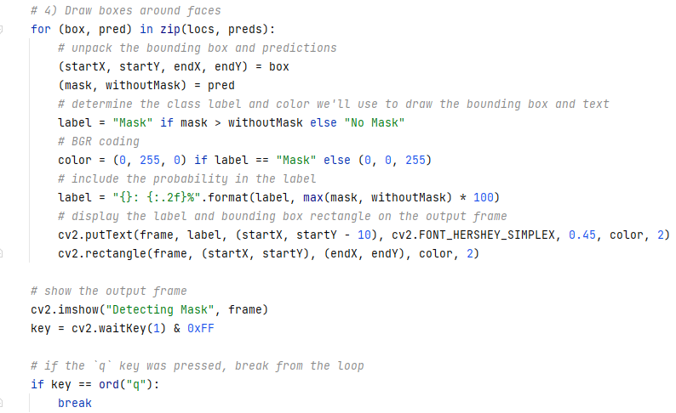
Program
Complete
Load models
2) Detect faces
4) Draw boxes around faces
1) Take a frame from the video stream
3) Detect masks

Slide 7
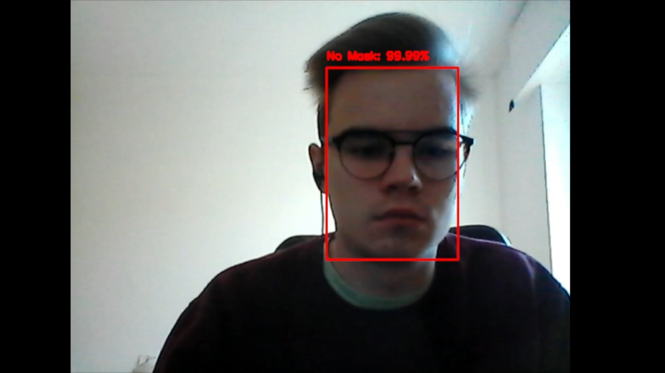
DEMO

